Slide 1
A tour of Vertex AI
Sara Robinson {Developer Advocate}
@SRobTweets

Slide 2
NDA
Vertex AI provides tools to support your entire ML workflow, across different model types and varying levels of ML expertise

Slide 3
Agenda
What is Vertex AI?
Datasets
Models
Deployment & Prediction
MLOps

Slide 4
What’s included in Vertex AI?
NDA
Data Readiness
Feature Engineering
Training/ HP-Tuning
Model serving
Understanding/ Tuning
Edge
Model Monitoring
Model Management
AutoML
Vision
Video
Language
Translation
Tables
Data Labeling
Feature Store
Training
Prediction
Hybrid AI
Continuous Monitoring
Metadata
Datasets
Vizier Optimization
Explainable AI
Experiments
AI Accelerators
Pipelines (Orchestration)
DL Environment (DL VM + DL Container)
Notebooks

Slide 5
That’s a lot! What’s the right tool for you?
Do you have your own training data?
No
Yes
Are you writing the model code yourself?
Pre-trained APIs
No
AutoML
Yes
Custom model tooling

Slide 6
That’s a lot! What’s the right tool for you?
Do you have your own training data?
No
Yes
Are you writing the model code yourself?
Pre-trained APIs
No
AutoML
Yes
Custom model tooling

Slide 7








Use a pre-trained model to accomplish common ML tasks
Cloud Vision
Cloud Video Intelligence
Cloud Speech-to-Text &
Text-to-Speech
Cloud Natural Language
Cloud Translation

Slide 8
Custom tasks
Create a dataset
Train a model
Deploy to an endpoint
Get predictions

Slide 9
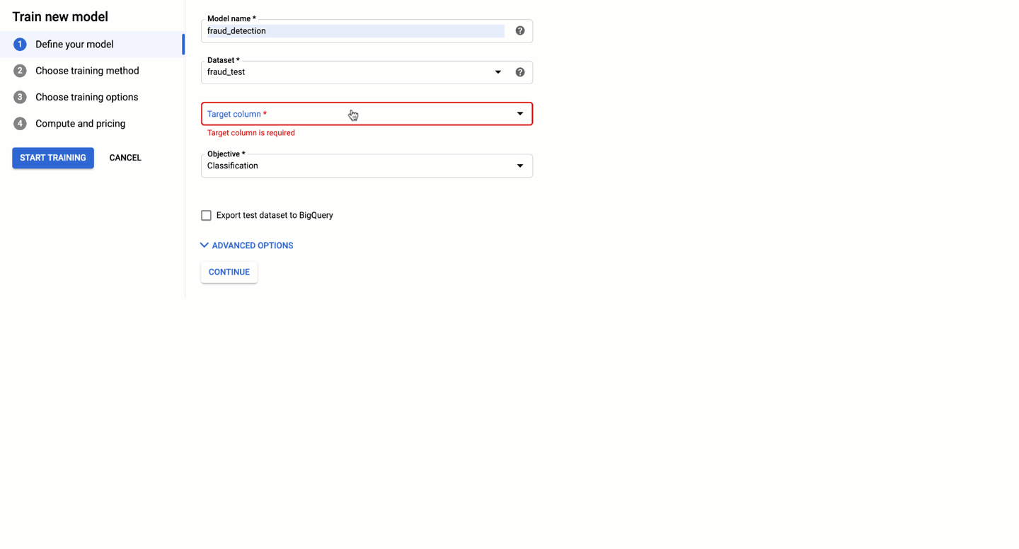
These tools support....
UI based model development
Programmatic model development
# Define job
job = aiplatform.AutoMLTabularTrainingJob(
display_name='price-predict-training',
optimization_prediction_type='regression'
)
# Run job
model = job.run(
dataset=ds,
target_column='median_house_value',
model_display_name='house-value-prediction',
)

Slide 10
Datasets

Slide 11
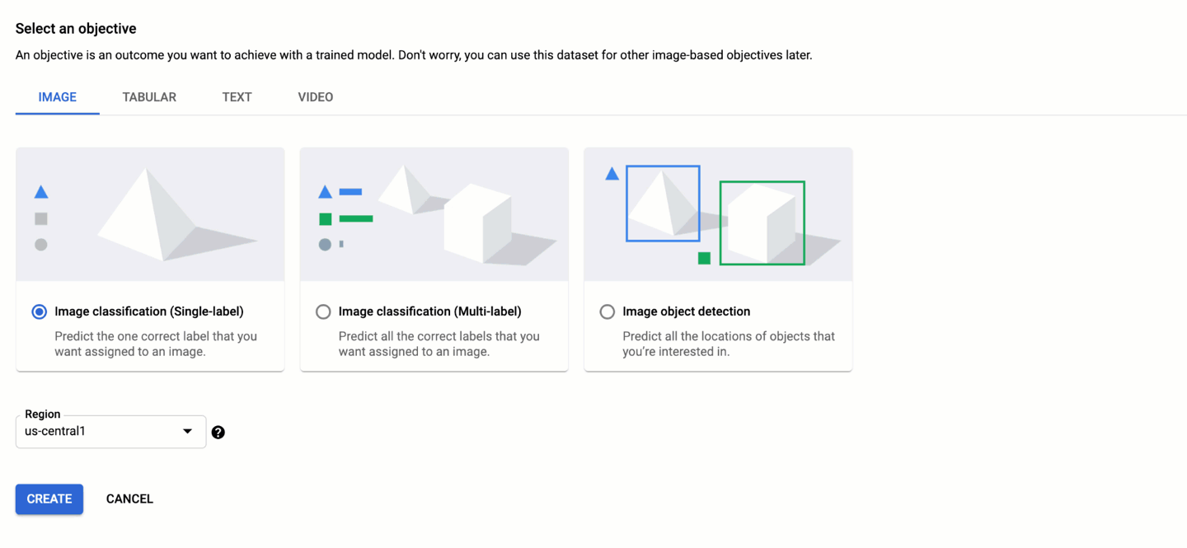
Choose your data type

Slide 12
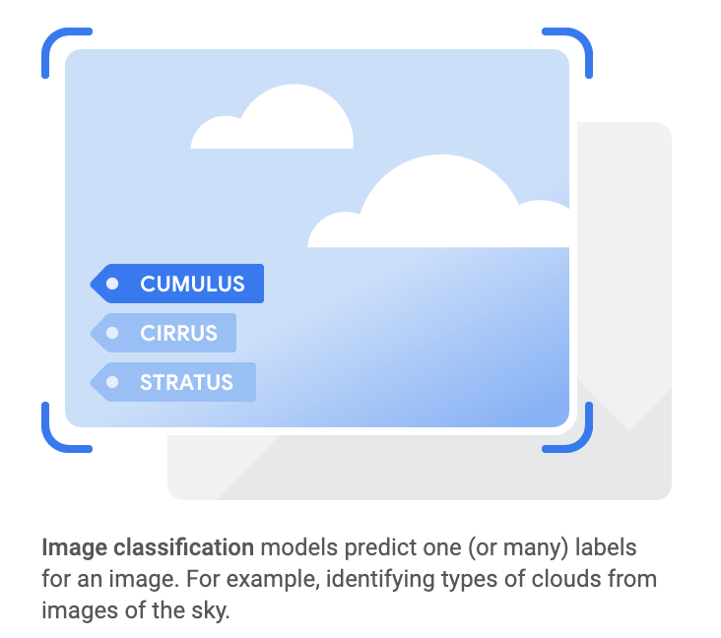
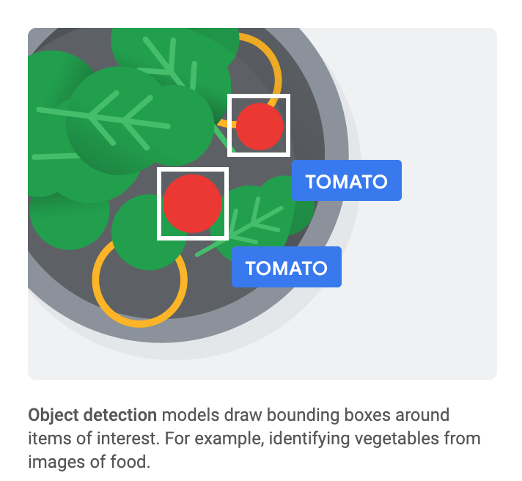
Image datasets

Slide 13
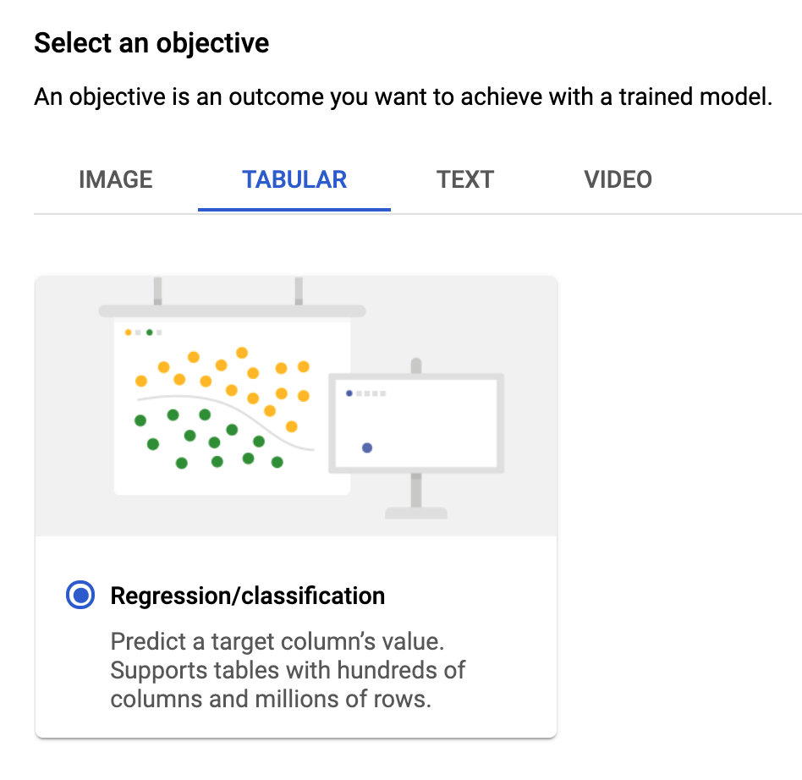
Tabular datasets

Slide 14
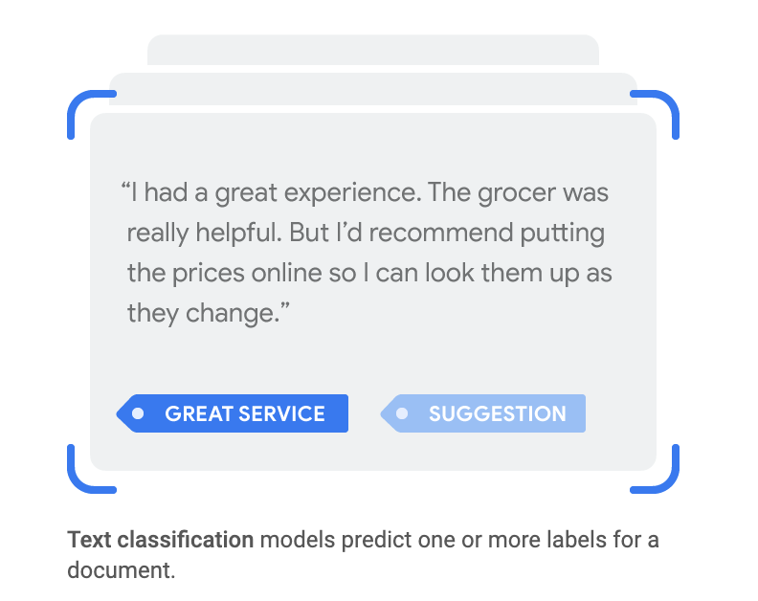
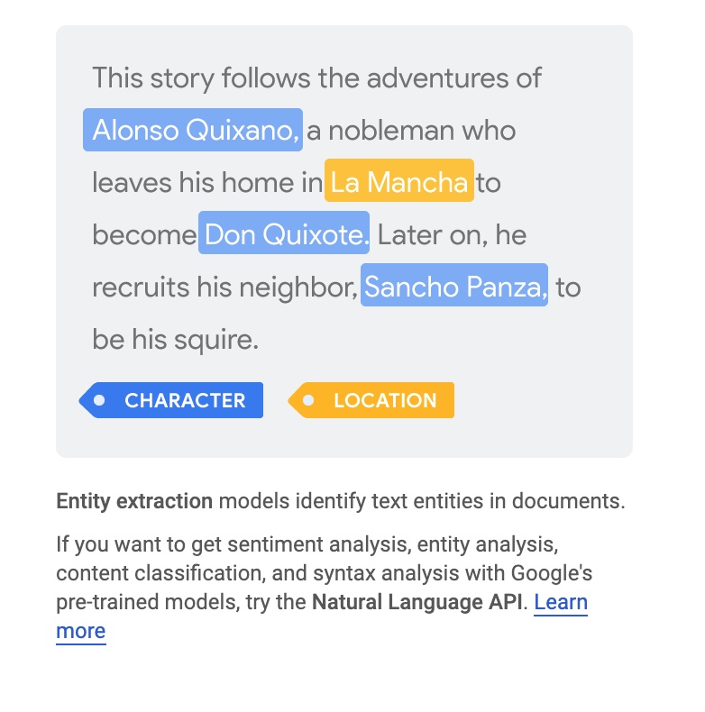
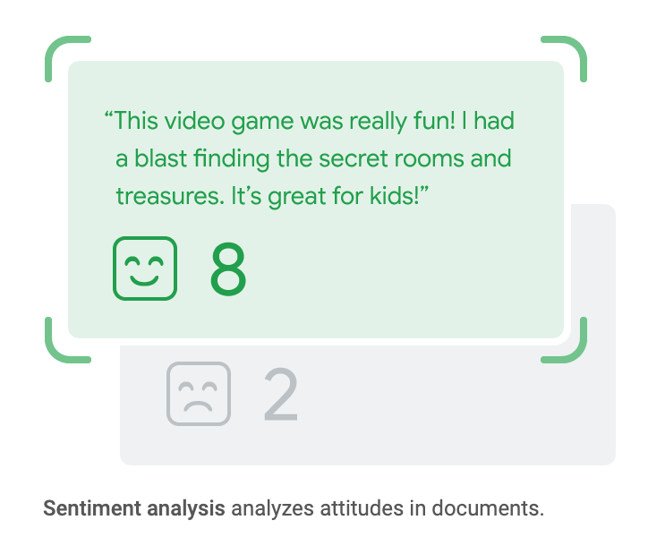
Text datasets

Slide 15
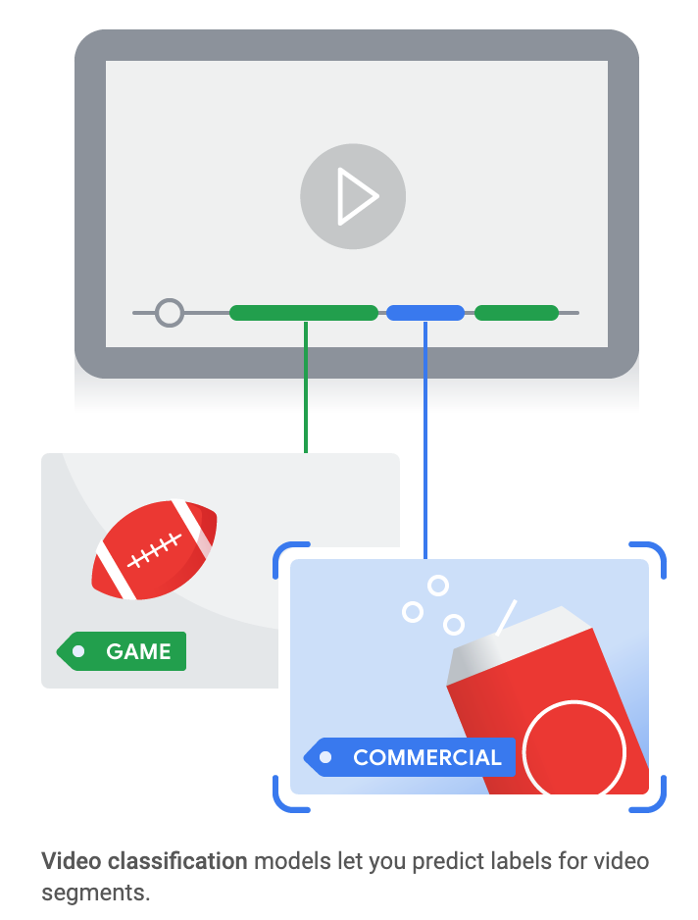
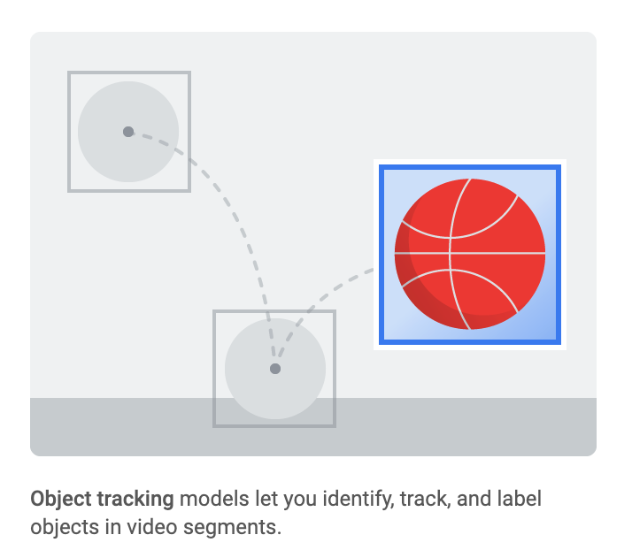
Video datasets

Slide 16
Models: build, train, evaluate

Slide 17
What’s the right tool for you?
Do you have your own training data?
No
Yes
Are you writing the model code yourself?
Pre-trained APIs
No
AutoML
Yes
Custom model tooling

Slide 18
What’s the right tool for you?
Do you have your own training data?
No
Yes
Are you writing the model code yourself?
Pre-trained APIs
No
AutoML
Yes
Custom model tooling

Slide 19
Should you write your own model code? It depends.
Use AutoML if... | Build a custom model if...
Your use case fits into our supported AutoML offerings: Image & video classification or object detection Text classification, entity extraction, sentiment Tabular regression, classification, or forecasting | Your use case doesn’t fit into any AutoML use cases OR Your model takes mixed input types, like images + tabular metadata
You don’t need to know specifics about the underlying model | You want control over your model’s architecture, framework , or exported model assets. For example, maybe your model needs to be built with TensorFlow
You want to develop a quick initial model to use as a baseline (which could end up being your production model) | You already have a baseline or heuristic and you want to see if you can improve upon it

Slide 20
What’s the right tool for you?
Do you have your own training data?
No
Yes
Are you writing the model code yourself?
Pre-trained APIs
No
AutoML
Yes
Custom model tooling

Slide 21
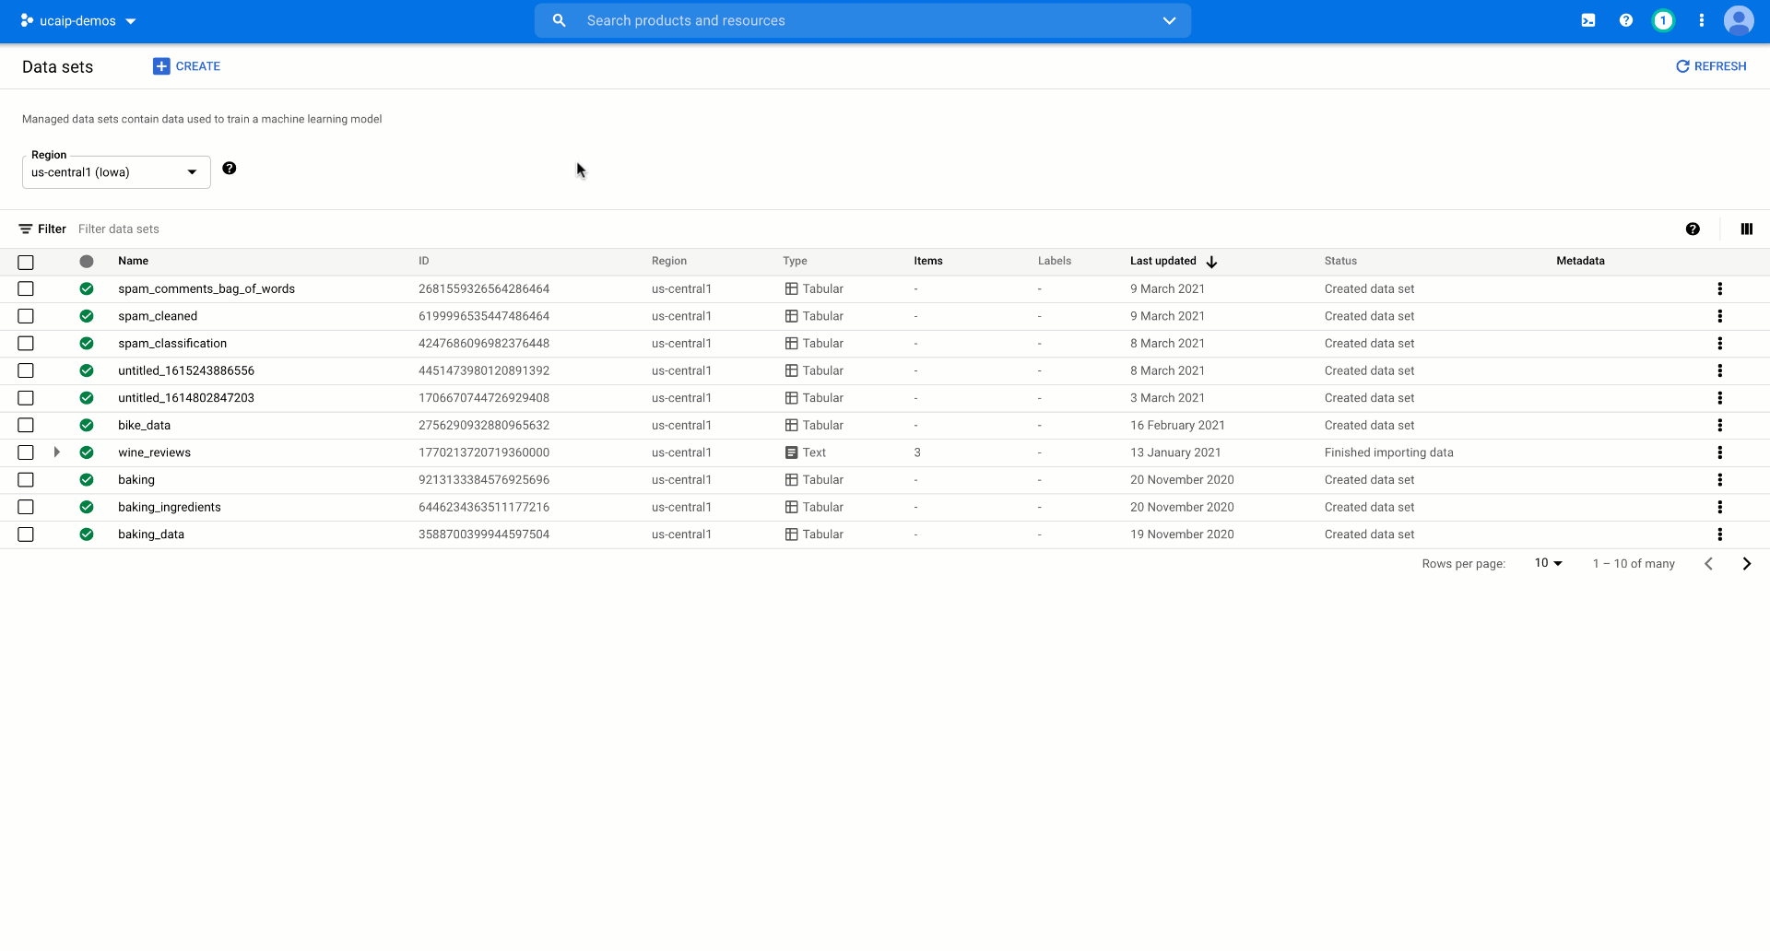
AutoML Training
Train state-of-the art models in less time without writing model code
Get detailed model evaluation metrics and feature attributions, powered by Explainable AI
‹#›

Slide 22
What’s the right tool for you?
Do you have your own training data?
No
Yes
Are you writing the model code yourself?
Pre-trained APIs
No
AutoML
Yes
Custom model tooling

Slide 23
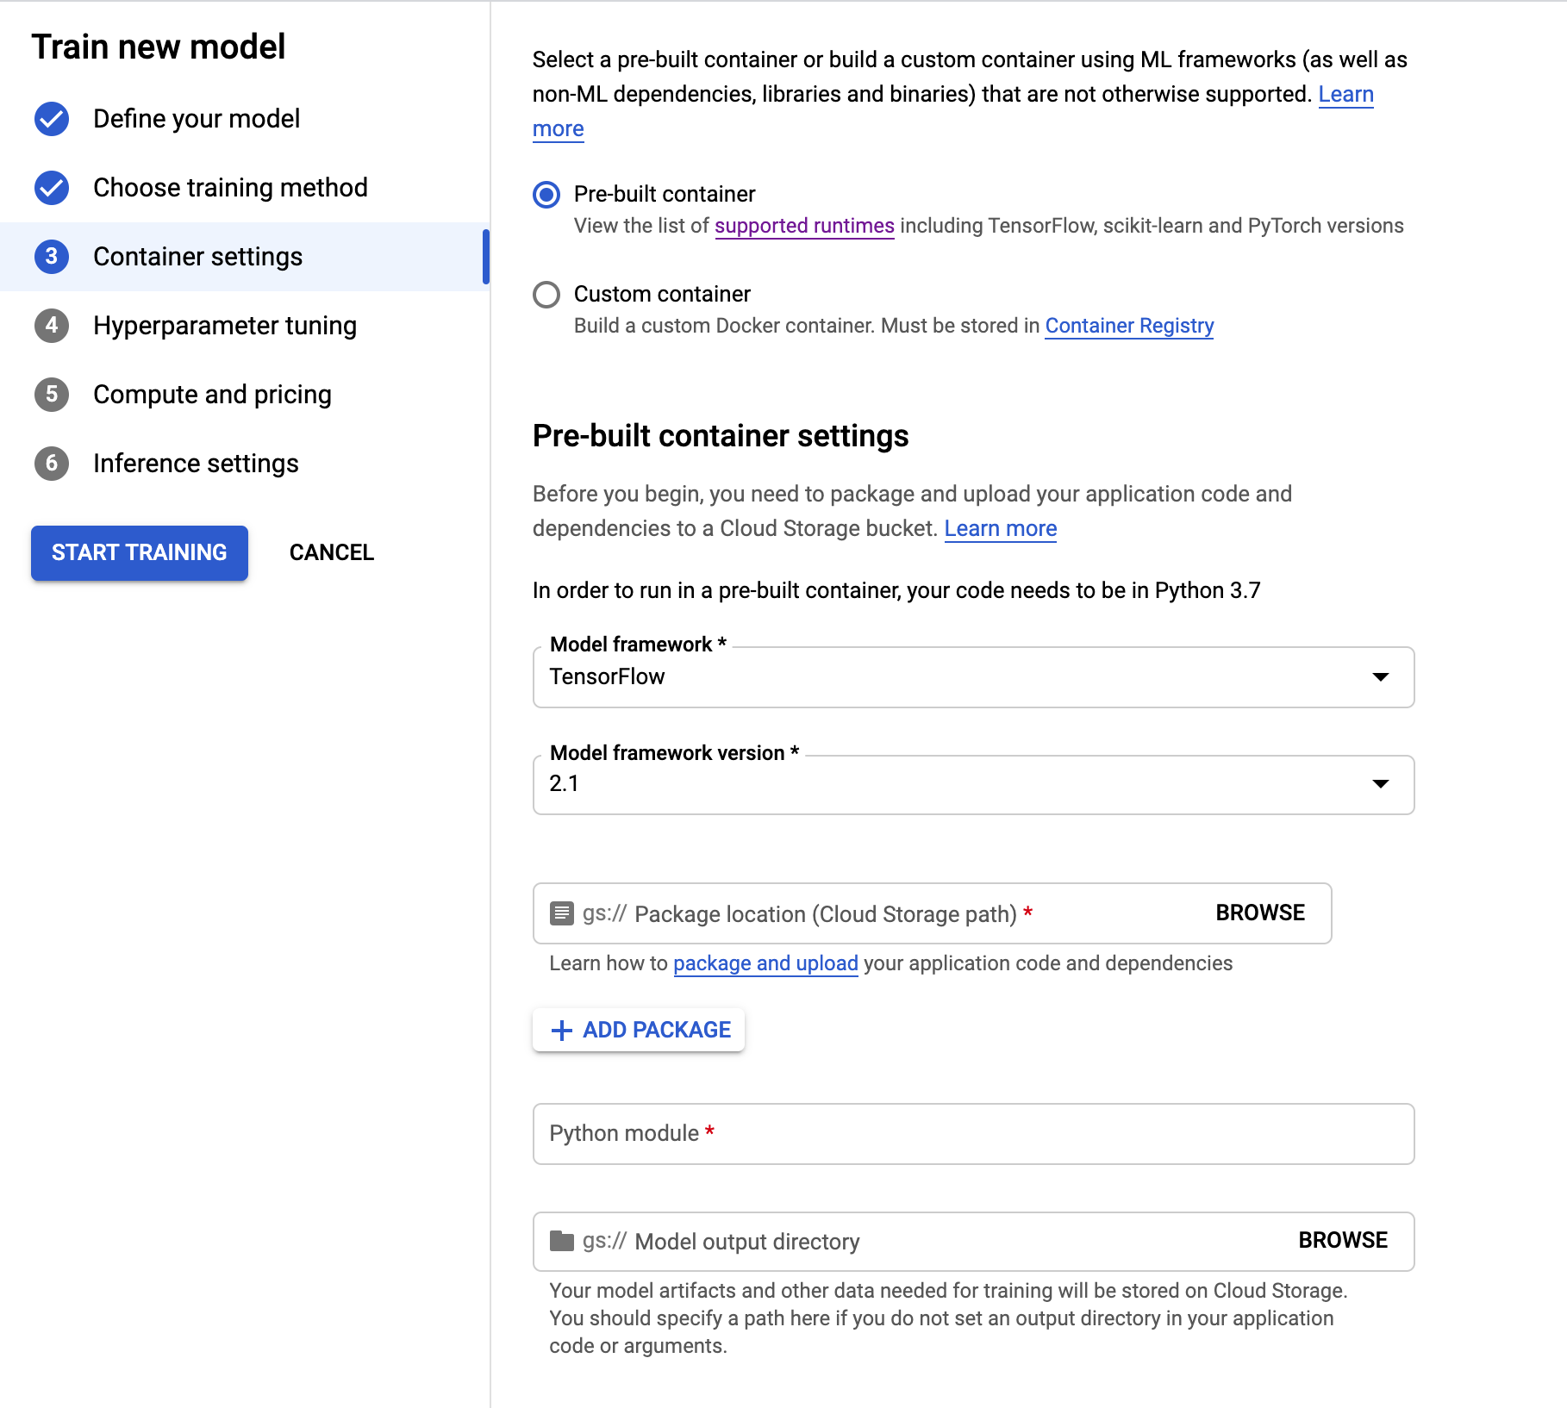
Custom Training
Train models build with a framework of your choice via custom containers
Run distributed training jobs and accelerate training with GPUs
Hyperparameter tuning with Google’s advanced Vizier optimization algorithm
‹#›

Slide 24
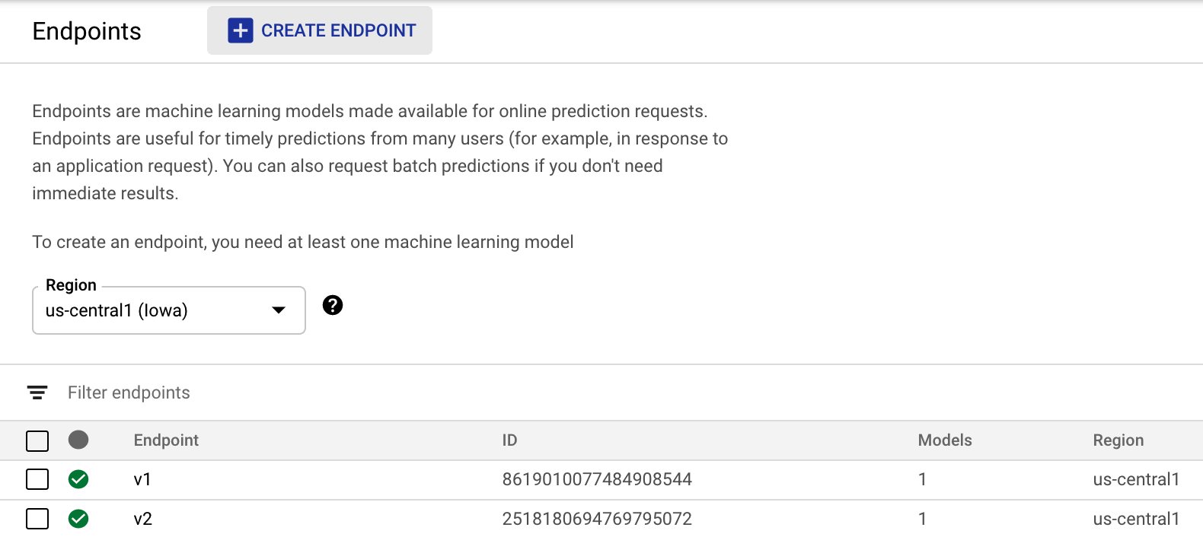
Scalable deployment with endpoints
Vertex Endpoints experience
Models trained with AutoML
Models trained with custom code
Serve models built with most commonly used ML frameworks
Split traffic between models
Customize endpoint machine types
‹#›

Slide 25
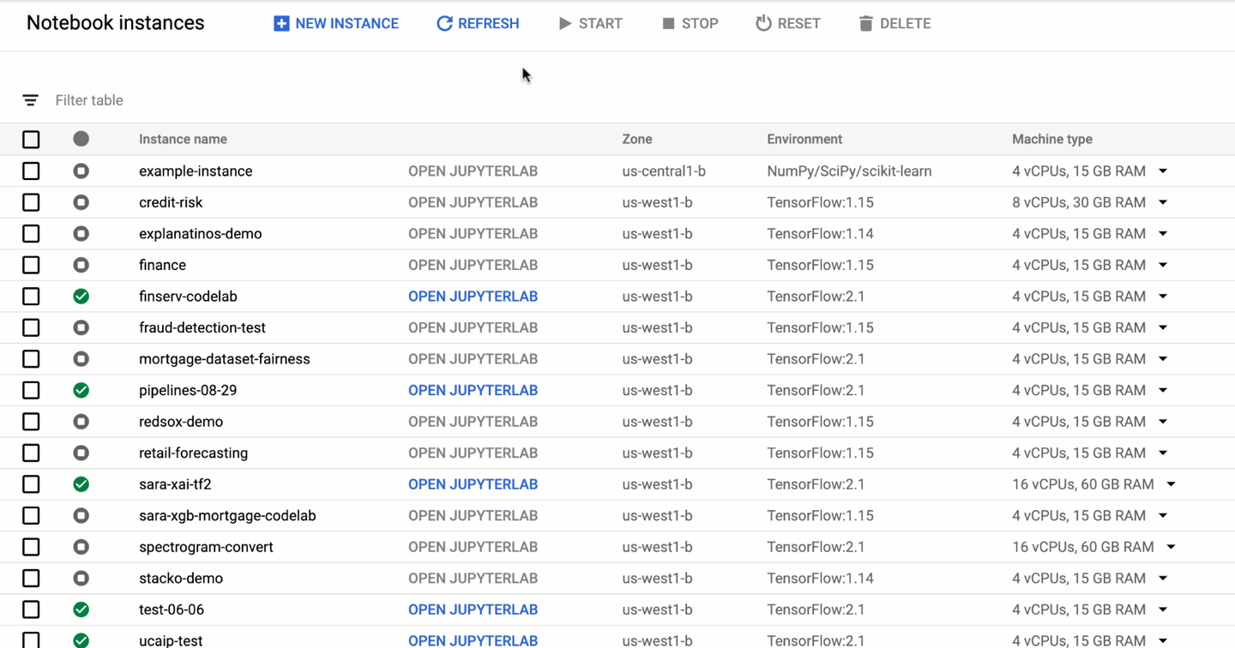
Notebooks: overview
A hosted Jupyter notebook solution
Popular data science and ML frameworks pre-installed
Customize your hardware
Direct git integration
Integrate with other GCP services

Slide 26
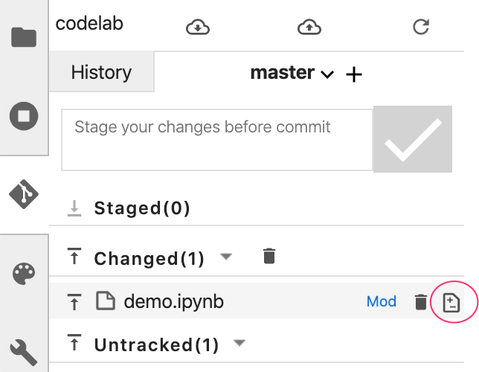
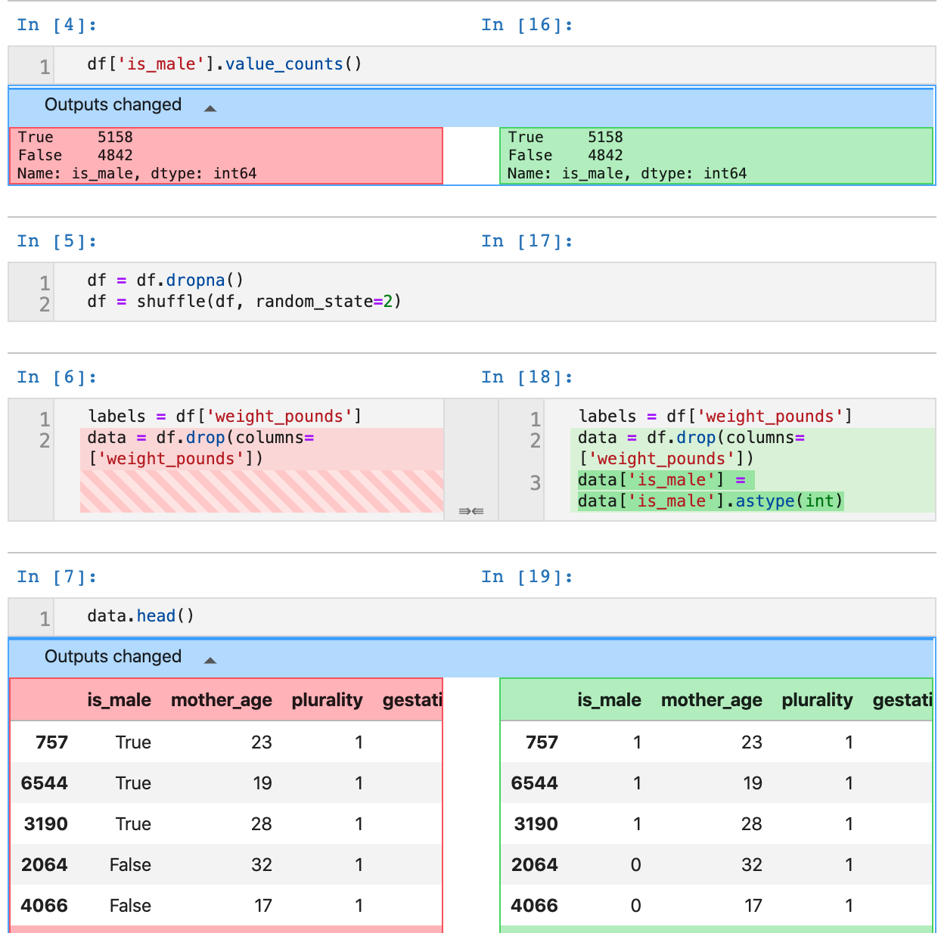
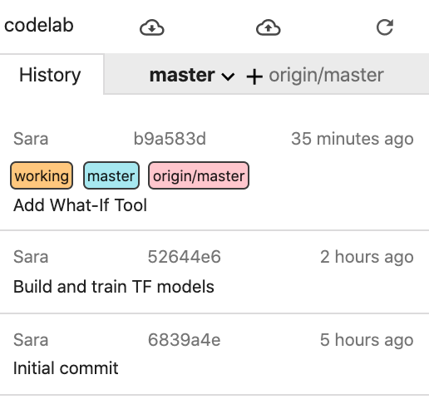
Notebooks: git integration

Slide 27
In a real-world scenario,
there will be many teams across an organization solving different ML problems.
‹#›
Notes:
So far we’ve seen how to prototype models and go from raw data to deployed endpoint. But chances are there will be multiple teams solving different tasks with ML across your organization. You need a way efficiently manage this at scale. That’s where MLOps comes in.

Slide 28
MLOps can help you productionize and standardize ML systems rapidly and reliably.
‹#›
Notes:
Equally important to building high-quality ML models is having reliable systems in place to manage and monitor the many resources associated with these models. This will allow for reliable, reproducible systems to ensure successful production ML. MLOps seeks to add discipline to the development and deployment of machine learning models by defining processes to make ML development more reliable and productive.

Slide 29
How can Vertex AI help with MLOps?
NDA
Data Readiness
Feature Engineering
Training/ HP-Tuning
Model serving
Understanding/ Tuning
Edge
Model Monitoring
Model Management
AutoML
Vision
Video
Language
Translation
Tables
Data Labeling
Feature Store
Training
Prediction
Hybrid AI
Continuous Monitoring
Metadata
Datasets
Vizier Optimization
Explainable AI
Experiments
AI Accelerators
Pipelines (Orchestration)
DL Environment (DL VM + DL Container)
Notebooks

Slide 30

How does MLOps fit into app development?
Application backend
Vertex AI
End-to-end platform for
ML model development
and deployment
Desktop client
Application logic
Mobile client

Slide 31
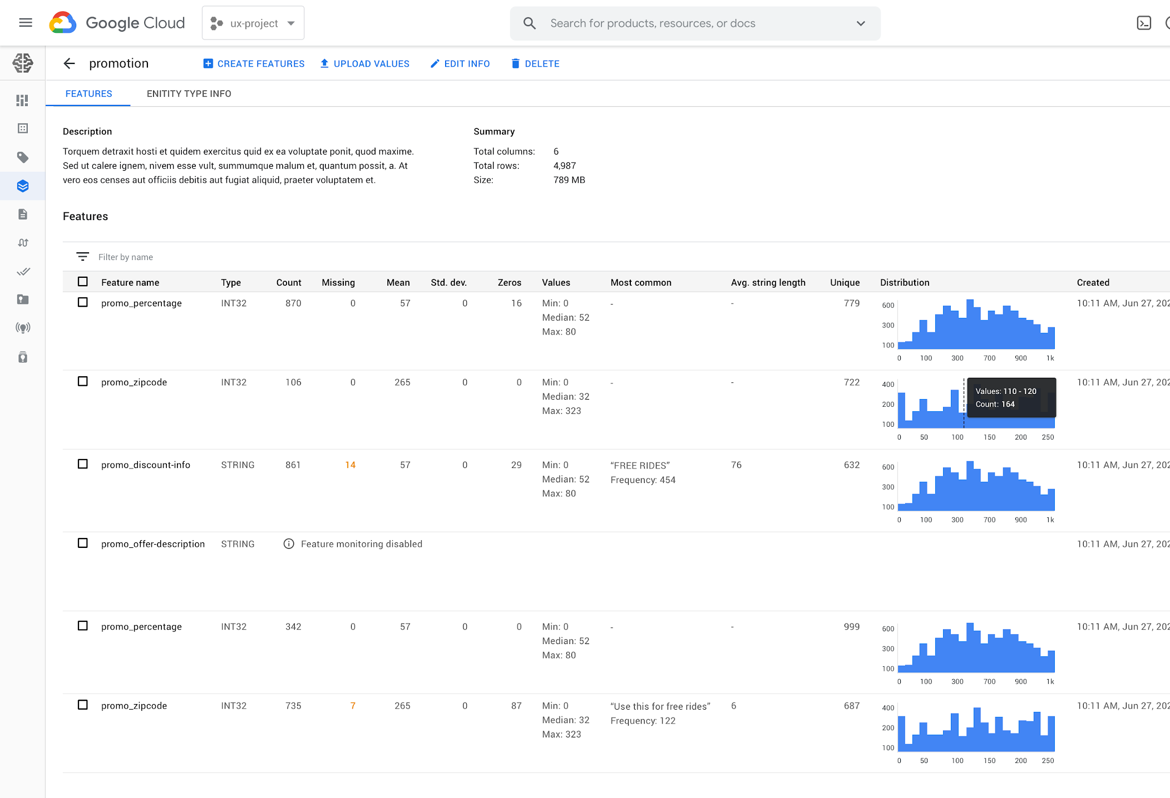
Feature Store
Share and reuse ML features across use cases
Serve ML features at scale with low latency
Alleviate training serving skew
‹#›

Slide 32
A deployed model is
only the beginning
To avoid concept and model drift, ML models often need to be continuously monitored, retrained, and updated.
Pipelines can help automate this workflow.
‹#›

Slide 33
Pipelines are the backbone of production ML systems
Pipelines are the backbone of production ML systems
1
2
3
4
Experimentation
(Re) Training
Model Deployment
Continuous Monitoring
EDA / Prototyping
Experiment Comparison
Production Training Pipeline
Model Serving
Canary & A/B Testing
Model performance monitoring
‹#›

Slide 34
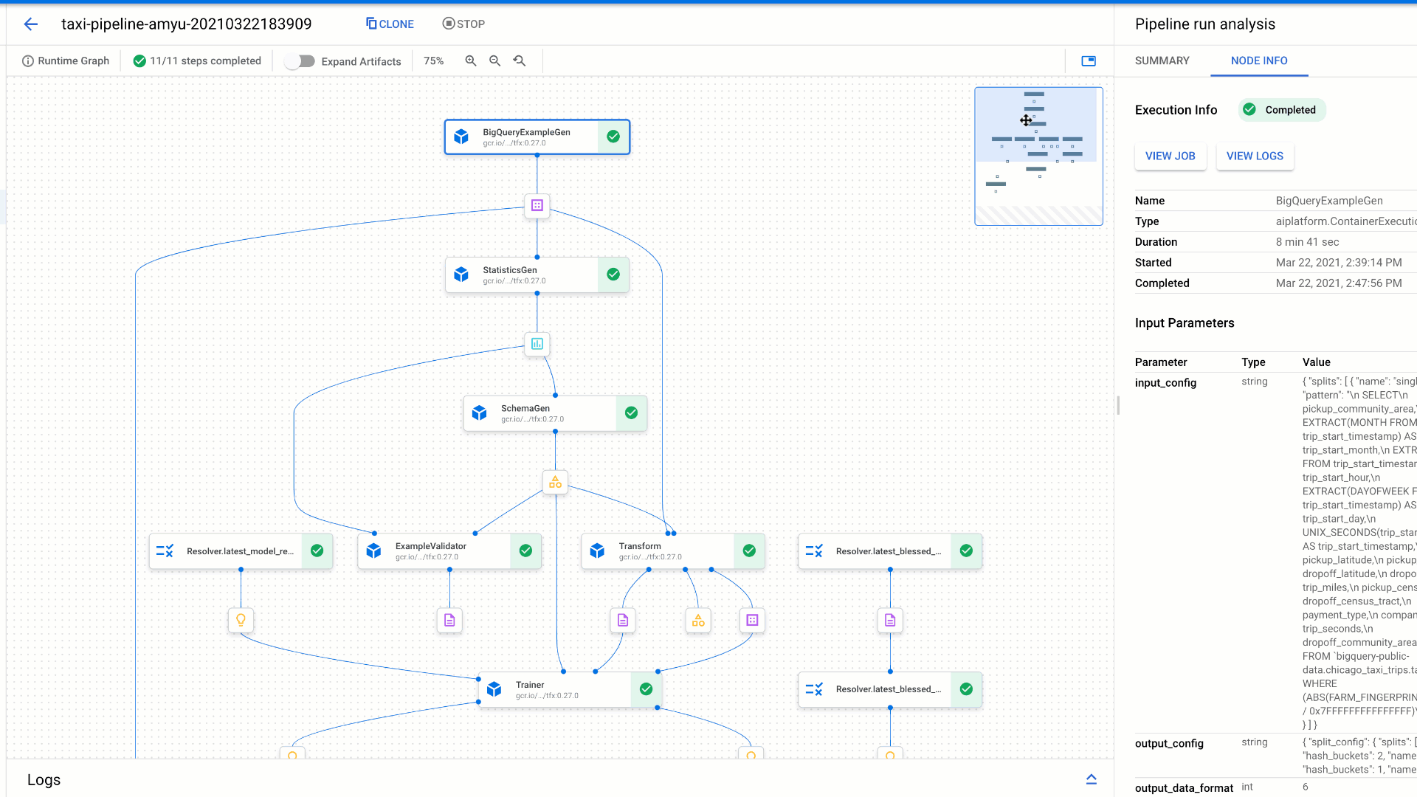
Managed Pipelines
Build pipelines with familiar open-source Python SDKs like TFX and Kubeflow Pipelines
Automated, scalable, serverless, cost effective: pay only for what
you use
‹#›

Slide 35
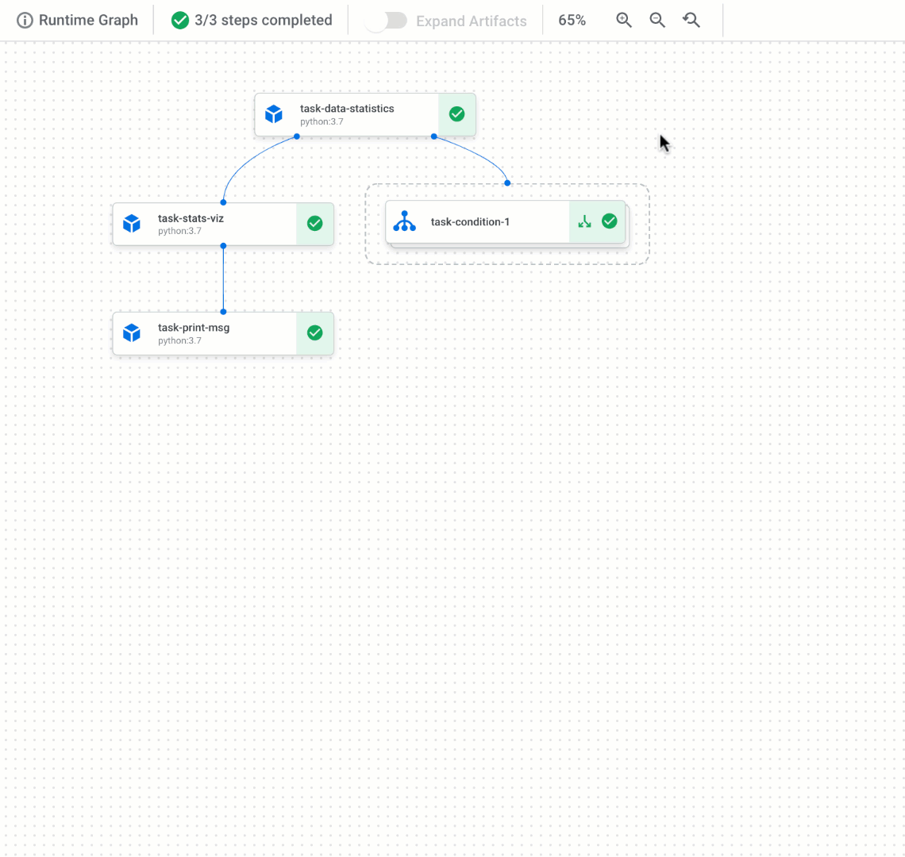
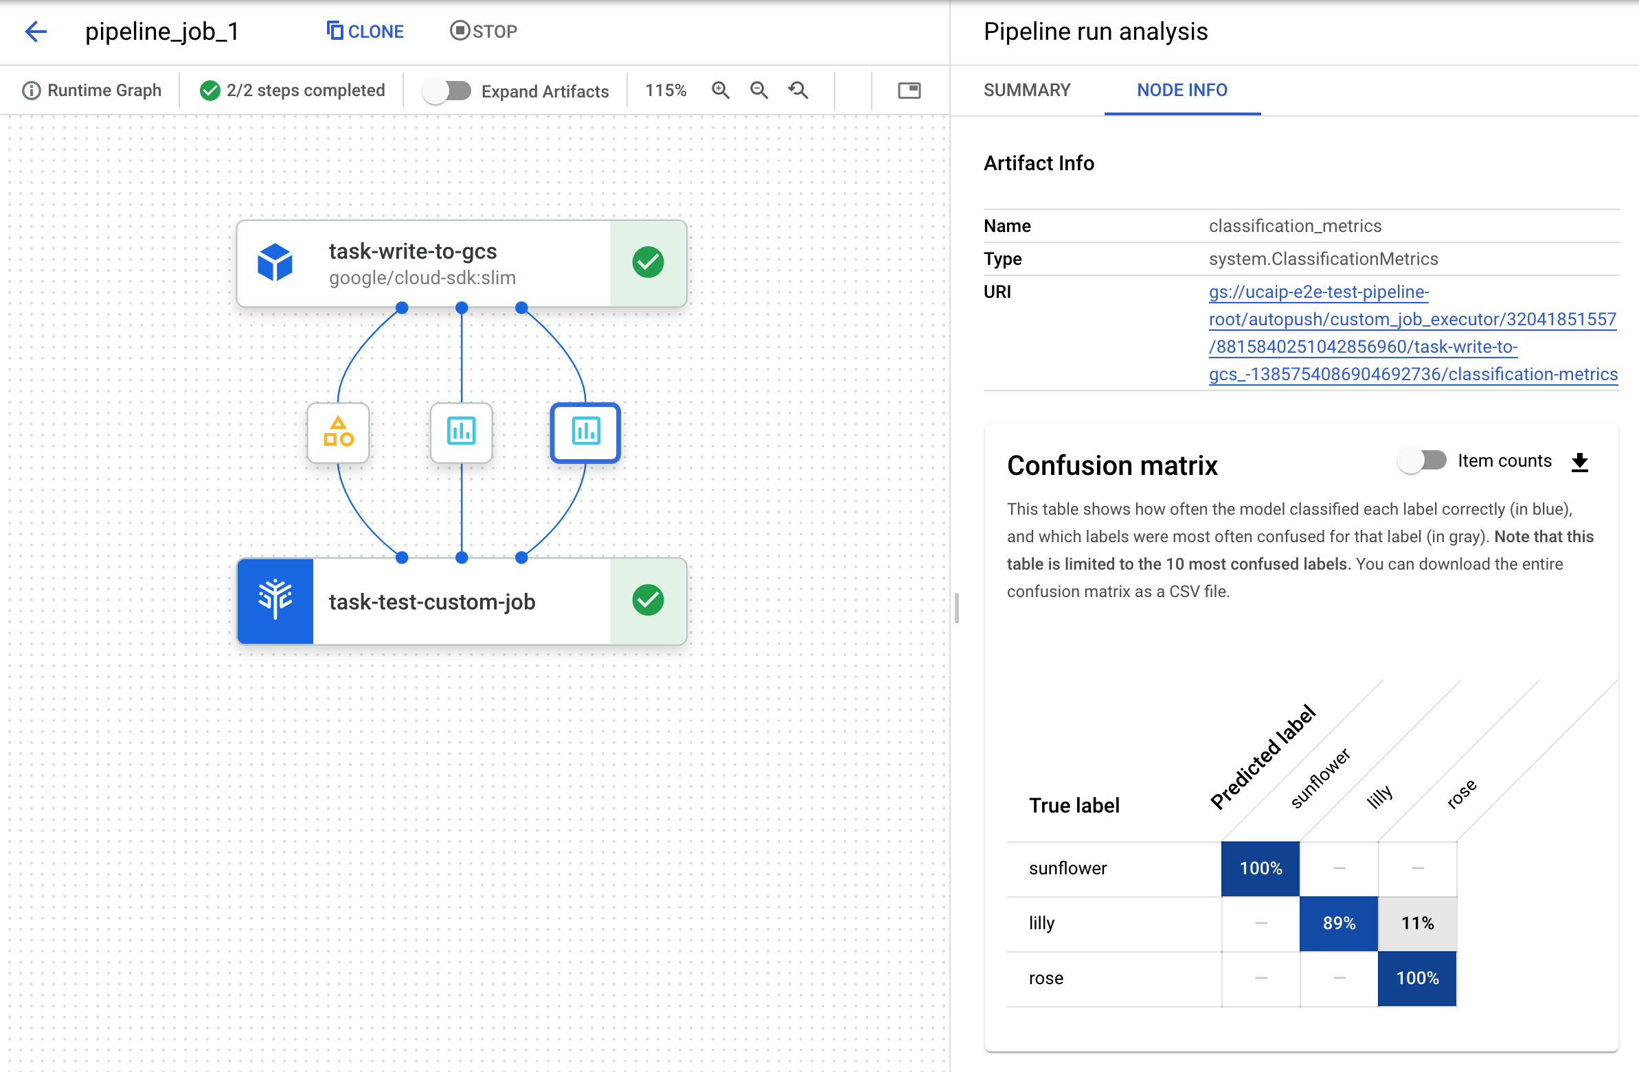
Managed Pipelines
Add conditional logic and branches to your pipeline
Store metadata for every artifact produced by the pipeline
Track artifacts, lineage, metrics, and execution across your ML workflow
Support for Cloud IAM, VPC-SC, and CMEK
‹#›

Slide 36
MLOps vs. DevOps
Unlike traditional programming, a model may not be functioning correctly even if the model prediction code still works
We need a way to continuously monitor our models to detect drift.
‹#›

Slide 37
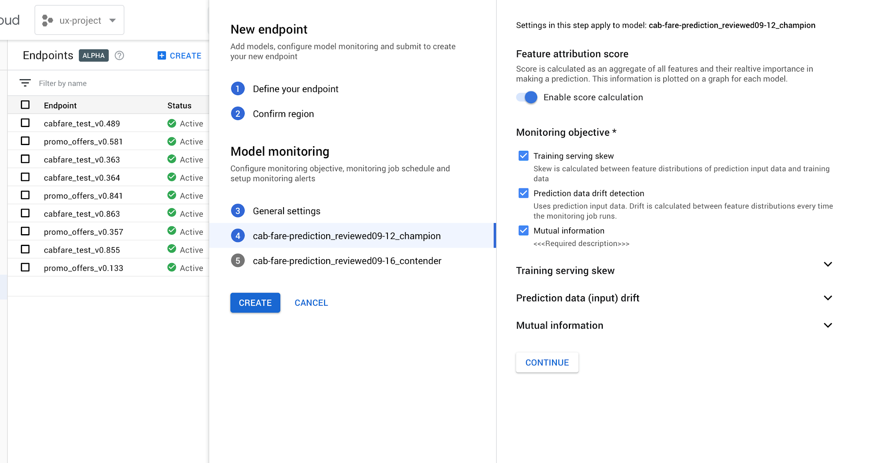
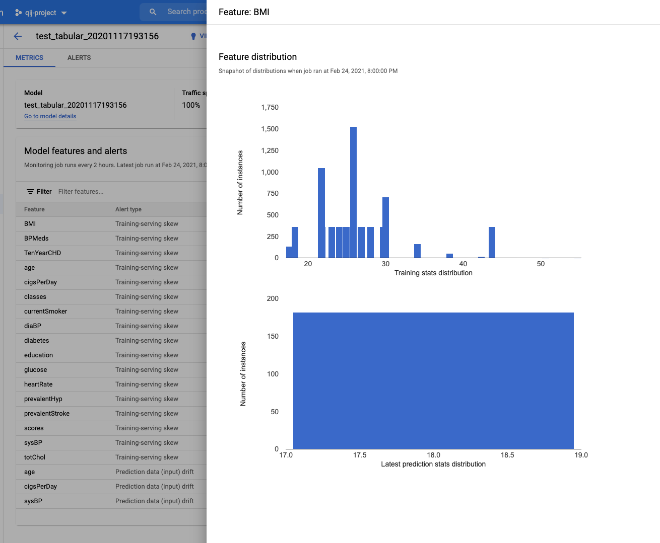
Automatically alert your data scientists and ML engineers when model performance changes
Detect drift and training-serving skew
Provides confidence in model reliability
Model Monitoring
Automatically alert your data scientists and ML engineers when model performance changes
Detect drift and training-serving skew
Provides confidence in model reliability
‹#›

Slide 38
Using Vertex AI throughout your ML workflow
Gather data & train model
Scalably deploy model
Streamline workflows with pipelines
Evaluate, monitor, retrain
‹#›
Gather data & train model
Scalably deploy model
Streamline workflows with pipelines
Evaluate, monitor, retrain

Slide 39
Learn more
Getting started docs: cloud.google.com/vertex-ai/docs
Get started in Cloud Console: console.cloud.google.com/ai/platform
Best practices: cloud.google.com/architecture/ml-on-gcp-best-practices

Slide 40

Thank you
@SRobTweets

